Slide 1
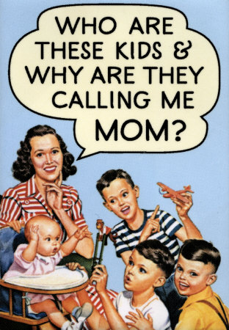
SC1101E WEEK 5
FAMILIES
Kelvin Low Department of Sociology National University of Singapore

Slide 2
Overview
What is a ‘family’? (Definitions; Historical Perspectives)
Theorising Families
Diverse Familial Forms
Families and Social Change/Policy

Slide 3
MCYS
Ministry of Community Development, Youth and Sports (Singapore)
The family is an important institution. It brings fulfillment to our lives and is our anchor in this fast-paced, ever-changing environment. Families serve as an important pillar of support for the nation. At the individual level, families are the primary source of emotional, social and financial support. At the national level, they contribute to social stability and national cohesiveness as they help develop socially responsible individuals and deepen the bond Singaporeans have with our country.
http://app.mcys.gov.sg/WEB/faml_main.asp

Slide 4

MCYS
National Family Week (May)
Recognises role of family & contributions to society
Encourages and supports healthy family life and values
‘Eat with your family day’
‘Jetty Jump’

Slide 5
I. Defining ‘Family’
Kinship, membership characteristics, legal recognition, and/or social function?
Kinship – members are linked by blood, marriage or adoption
Primary kin – parents, siblings
Secondary kin – grandparents, nieces & nephews
Tertiary kin – brother’s daughter’s son, mother’s sister’s son

Slide 6
I. Defining ‘Family’
No such thing as ‘the family’ (single, timeless, homogeneous entity)
An institution for rearing children?
Any group of persons with ties of kinship?
Any group or couple in which members provide for or rely on others financially, emotionally, or both?
Any household comprising interdependent residents?

Slide 7
I. Defining ‘Family’
‘Family’ as a rhetorical term – does not refer to a concrete phenomenon
Families have been structured in many ways, and diversity of familial forms have been increasing

Slide 8
Defining ‘Family’ –Historical Perspectives
Tracing aspects of family interaction
Generalities and diversity
‘Euro-Western’ families
Families in Asian contexts

Slide 9
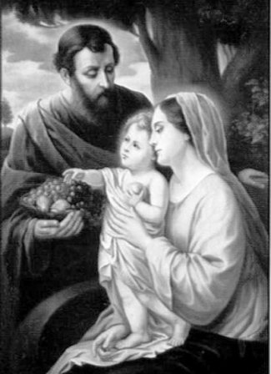
Defining ‘Family’ – Historical Perspectives
Euro-Western contexts
Focus: sexuality and power
Much of Western history characterised by husbands’ dominance over wives and children

Slide 10
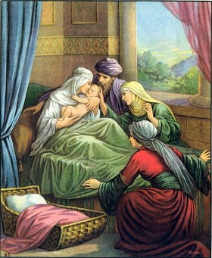
Defining ‘Family’ – Historical Perspectives
Hebrews 12th century B.C.
Patriarchy & wives
Marriage
Love
Female inferiority
Notes:
Women belong to men. And women is regarded as property and commodity

Slide 11
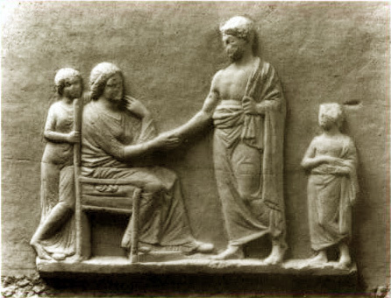
Defining ‘Family’ – Historical Perspectives
Greeks
Female subservience
Marriage
Men and intellect versus women as non-rational
Children
Homosexuality
Notes:
Almost the same as Hebrew. They invented the Chasity belt. Only sons can inherit. Homosexuality is considered as a norm as it promotes man and man intellectual exchange.

Slide 12
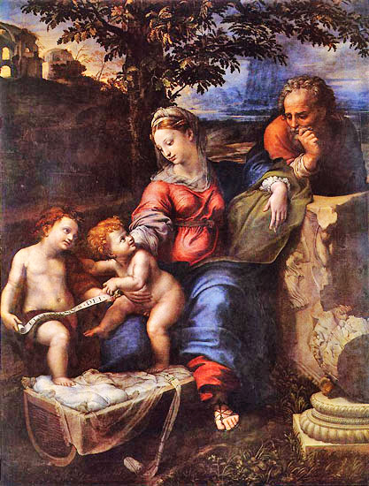
Defining ‘Family’ – Historical Perspectives
Renaissance, 14th-17th century
Shifts in family structure
Ideas of romantic love

Slide 13
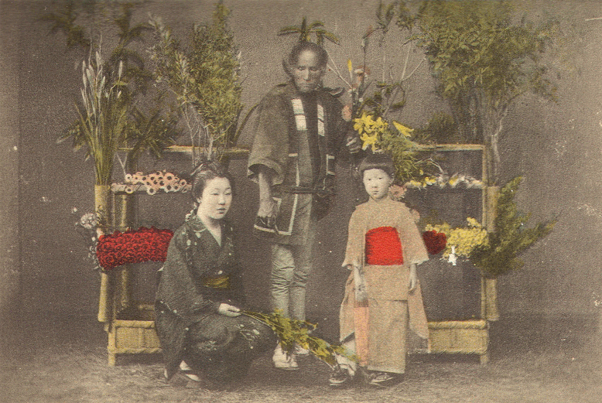
Defining ‘Family’ – Historical Perspectives
Asian contexts
Early Japanese families, before 100 AD
Equality of men & women
Children
Sexual behaviour
Meiji era (1868-1912)
family name
Notes:
Childrens are raised at the wife’s home. Pre-martial sex is considered as norm.

Slide 14
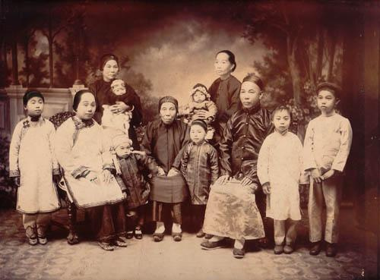
Defining ‘Family’ – Historical Perspectives
China
Confucianism – family hierarchy, obligation, duties
Patriarchy
Homosexuality
Chinese mothers
1915 turning point
Notes:
Males or eldest sons or fathers have dominating roles. Homosexuality is allowed as long as they fulfil their procreation role. Chinese youths against the aberration of women from 1915 onwards. Family structures can change due to changing social pressures.

Slide 15
Defining ‘Family’ –Historical Perspectives
Cultural change across time
Family practices in different socio-temporal contexts (similarities/differences)
Gender Relations
Sexuality

Slide 16
II. Theorising Families
Feminist Theory
Conflict Theory
Functionalism
How do we analyse what the family does for its members?
How do we critically explain and evaluate patriarchy in the family?
Symbolic Interactionism

Slide 17
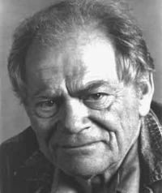
II. Theorising Families - Functionalism
Families to serve social functions (Murdock 1949)
Regulate sexual behaviour
Reproduction
Socialise the young
Provide care and emotional support
Economic cooperation
Notes:
Nuclear family is a common structure globally.

Slide 18
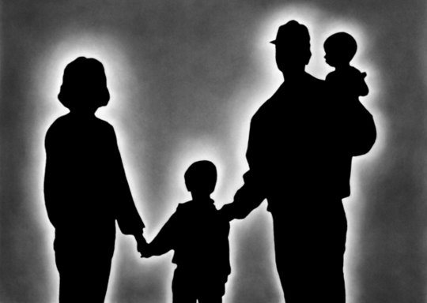
II. Theorising Families - Functionalism
Pervasiveness of nuclear family as evidence of its ability to perform the functions raised earlier
Nuclear family: comprising mother, father, and their offsprings (Murdock)

Slide 19
II. Theorising Families
Critique of Functionalism
Does functionalism provide an accurate picture of family relations at any point in human history?
Assumption of the nuclear familial form and its functions?

Slide 20
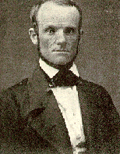
II. Theorising Families
Critique of Functionalism
Nuclear family not universal form
Example: Oneida Community
Founded in Oneida, NY, 1848 by John Humphrey Knowles
Sexual activity allowed among members
Eugenics
Raising of children communally
Notes:
For example, the women has at least 3 sexual activity every week. And a person is assessed if he is suitable as a parent (genetically donors) through their morals.

Slide 21
II. Theorising Families – Conflict & Feminist Perspectives
Gender conflict and social inequality
Oppression, particularly oppression of women
Changing policies, domestic violence, recognising unpaid labour, etc
Notes:
Feminist- end oppression of women.

Slide 22
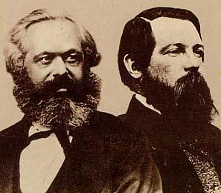
II. Theorising Families – Conflict Perspective
Sees the family as a social arrangement benefitting some people more than others
Engels viewed the family as a class society in miniature, with one class (men) oppressing another class (women)
Notes:
Families have conflicting interests, and some members of the family have more power to wield power over the weaker members. E.g. Exploitation of the women

Slide 23

II. Theorising Families – Feminist Perspective
Focus on patriarchy as a source of women’s powerlessness in families
Women’s oppression
Families are power-based
Different resources and power for men and women

Slide 24

II. Theorising Families – Feminist Perspective
Women, feminist theorists argue, do not enter family with full resources comparable to men’s
They therefore suffer inequality in close relations
Different schools of Feminism
Liberal Feminism
Marxist Feminism
Radical Feminism

Slide 25
II. Theorising Families – Feminist Perspective
Liberal Feminism
Primarily concerned with plight of middle and upper class women and their families
Women should be given equal opportunities as men
Equal rights (civil and legal)
Critique?
Notes:
2 Shifts. Women need to balance work and family due to social attitudes. Is paid employment the best route to ensuring equality in women?

Slide 26
II. Theorising Families – Feminist Perspective
Marxist Feminism
Women’s oppression resulting from capitalist exploitation of women through their roles in the family
Patriarchy as product of capitalism
Critique?
Notes:
Free provision of labour as care-takers to perform the role.

Slide 27
II. Theorising Families – Feminist Perspective
Radical Feminism
Views sexism as most pervasive form of discrimination
Oppression of women through (1) domestic labour (2) sexuality/reproduction
Control over one’s body as essential to women’s liberation
Other issues
Contraception and abortion rights
Legislation of domestic and sexual violence
Notes:
Key word: the control of female’s body. IMPT so that they can develop rational capability.

Slide 28
II. Theorising Families – Symbolic Interactionism
Interactions and meanings within families
Thomas & Znaniecki (1958) The Polish Peasant in Europe and America
Role analysis
Role-making, role definition, role negotiation, role identity

Slide 29
II. Theorising Families – Symbolic Interactionism
Roles or societal expectations
How are these roles constructed, learned, and played out?
The role of husband emerges and becomes meaningful in relation to the role of wife; the role of father invites contrast and comparison to counter-roles of wife and children
Notes:
Who is the provider and who is the care-taker

Slide 30
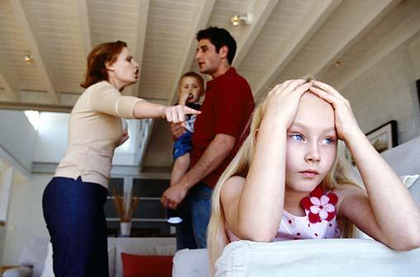
II. Theorising Families – Symbolic Interactionism
E.g. children who grow up in homes where adults hit one another or shout at one another

Slide 31
FAMILY
FUNCTIONALISM
Meet the needs to socialise children and reproduce new members
CONFLICT THEORY
Reinforce and support power relations in society
FEMINIST THEORY
Reflect gender
hierarchies in society
SYMBOLIC INTERACTIONISM
Interactions and meanings among family members

Slide 32
III. Diverse Familial Forms
Beyond the normative nuclear family form, there have always been different familial forms across time (cf. Howard 2011):
Cohabitation
Same-sex unions and partnerships
Single-parent families
Divorced and separated couples
Step families
Grandparents caring for grandchildren
Multiethnic

Slide 33

III. Diverse Familial Forms
Cohabitation
Couples living together without being married and who may have children together
Different backgrounds of cohabitators
Increases over the decades
Reasons for increase?

Slide 34
III. Diverse Familial Forms
Cohabitation – Reasons?
Cultural reason – norms and sexual relationships
Adaptation – high divorce rates; challenges facing married couples
Long-term alternative to marriage
Cohabitation – Structural consequences?
New definitions of kin networks; inheritance
New legislation (welfare; entitlements)
Notes:
Try living out together. Can it function? Social Welfare eligibility?

Slide 35
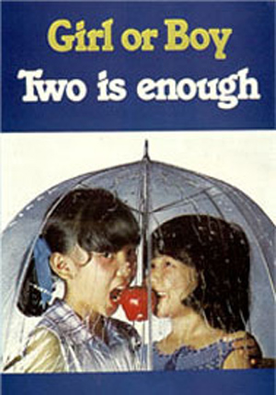
IV. Family & Social Change/ Policy
Family planning
Marital rape
1970s

Slide 36
IV. Family & Social Change/ Policy
Family policies on population growth
“Stop at Two” (1970s)
“Have Three or more Children if You Can Afford” (1987)
Present-day: Birth rate problems, elderly dependent ratio

Slide 37
IV. Family & Social Change/ Policy
Family policies on population growth
“We must further amend our policies, and try to reshape our demographic configuration so that our better-educated women will have more children to be adequately represented in the next generation…we shouldn’t get our women into jobs where they cannot, at the same time, be mothers…You just can’t be doing a full-time heavy job like that of a doctor or engineer and run a home and bring up children”
Then PM LEE K.Y., NDR 1983

Slide 38
IV. Family & Social Change/ Policy
Family policies on population growth
Having said "no" for a very long time, Prime Minister Lee Hsien Loong signalled yesterday that the time is right to say "yes" to having paternity leave, as the Government continues its efforts to increase Singapore's falling birth rate. Paternity leave could take the form of exclusive leave for husbands, or converting some part of maternity leave for them, suggested Mr Lee in his National Day Rally speech. "We've said 'no' for a very long time, but I think it's time we change, to signal the importance of the father's role and to signal your shared responsibility for raising your children," said Mr Lee.
TODAY, 27 August 2012

Slide 39

IV. Family & Social Change/ Policy
Marital Rape
Campaign against marital rape, Straits Times 19 July 2009
Three young professionals - are asking the Government to abolish a controversial law that grants immunity to husbands who force their wives to have sex with them.

Slide 40
IV. Family & Social Change/ Policy
Marital Rape
Section 375(4), known as the “marital rape exemption”, provides that non-consensual penetration by a man of his wife’s vagina, using his penis (“marital rape”), will not constitute the offence of “rape” except in limited circumstances.
Section 376A(5) provides a “marital rape exemption” whereby this offence is not committed by a man who uses his penis to penetrate the vagina of a girl who is under the age of 16, provided they are married to each other.

Slide 41
IV. Family & Social Change/ Policy
Marital Rape
In their research, the trio found that while there are no statistics on marital rape cases in Singapore, police figures showed that in an overwhelming majority of rapes, the victims knew the attackers. The number of legal protection orders taken up here - 2,500 in 2007 - also suggested marital rape could be an issue.
One victim, a mother of three, said she had no recourse during her 12-year marriage, which ended in 1997 when she walked out. 'I hope the law can be changed to protect all women,' said the 57-year-old secretary, who declined to be named.

Slide 42
Summary
What is a ‘family’?
Form and function; historical perspectives
Theorising Families
Different perspectives to analyse form and function, roles, norms, etc
Family Diversity
Changing configurations of families in different contexts
Families and Social Change/Policy
Linking families to policies and legislations

